Slide 1
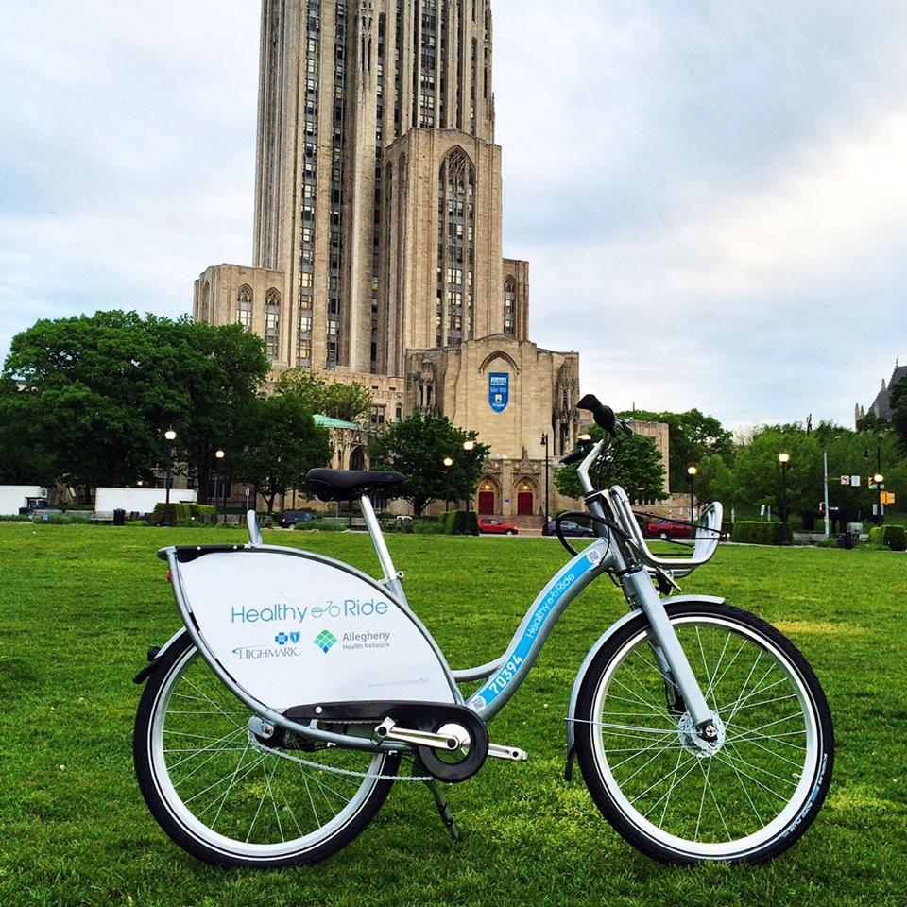
Bike Sharing DEMAND PREDICTION
Sai Charan Talipineni (sat122)
Sai Rakesh Ghanta (sag163)

Slide 2
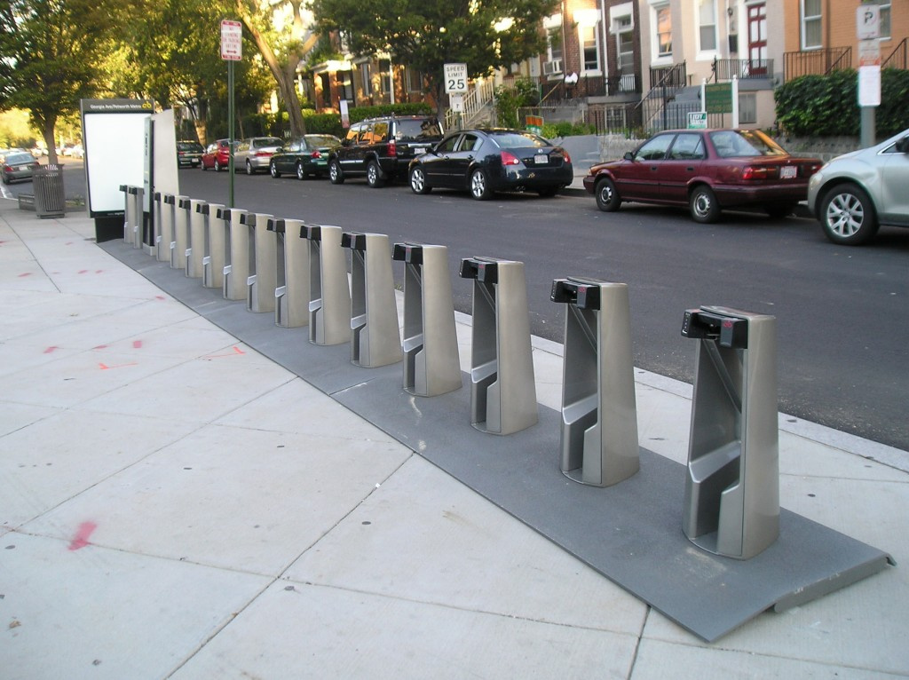
Motivation
In the modern day, health consciousness is increasing.
Pittsburgh bike sharing is becoming popular day to day.
Dynamic demand of bikes turns out it into an unbalanced system.
Help the bike rental company to pre-arrange the distribution of bikes in each station.
Minimize unnecessary waste of resources, and improve efficiency.

Slide 3
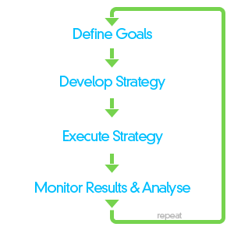
Project Goals
Address the ‘rebalancing’ problem, (at a particular station, at a particular time of a day, rent and return behavior)
Discover association between bike flow and different predictors
Find out what factors that could affect the bike rentals & showcase their significance.
Predict the number of bikes rented at a particular station, at a particular time of a day (future work).

Slide 4
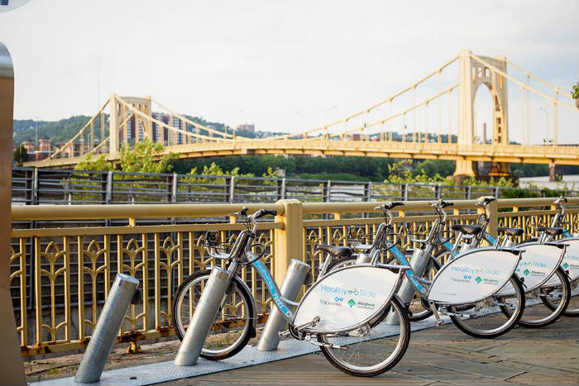

Healthy Ride | Pittsburgh's Bike Share System
Start Date: May, 2015
Pay As You Go Model
50 Stations
500 Bikes
Health/Fitness
Environment friendly
Cheap

Slide 5



Data Collection
Sources:
Bike Rental & Station Data from official Healthy Ride Pgh website
https://healthyridepgh.com/data/
Weather data from National Climatic Data Center – NOAA
Holiday Schedule from official city of Pittsburgh website.

Slide 6
Data Cleaning
Took the temperature as average of MAX and MIN.
Divided the temperature into low (<45), medium(>45 and <70) and high(>70).
Included Saturday and Sunday along with the holiday schedule.
Coded holiday = 1 and Non-holiday = 0.
Added the attribute week of the year.

Slide 7
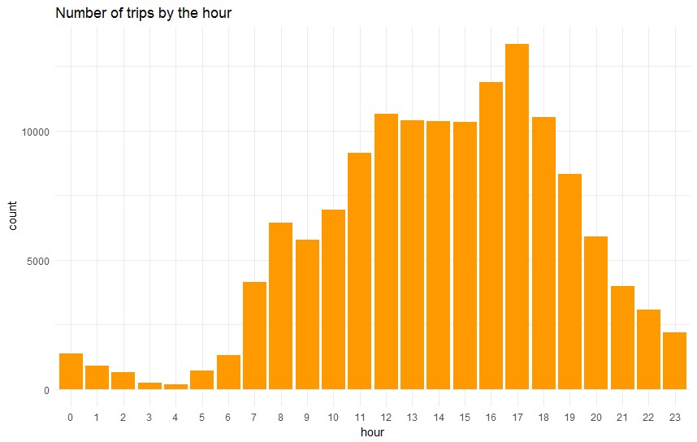
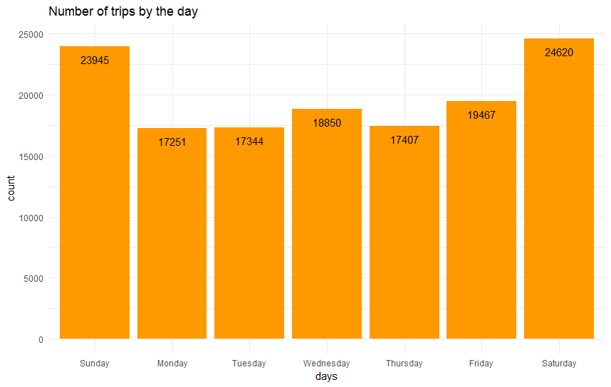
Data Exploration & Visualization
Plot of the count of bike rides in
different hours of a day
Plot of the count of bikes rented across
different days of the week

Slide 8
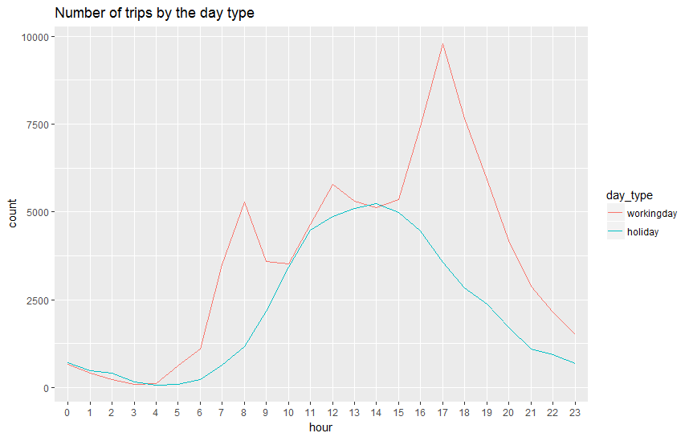
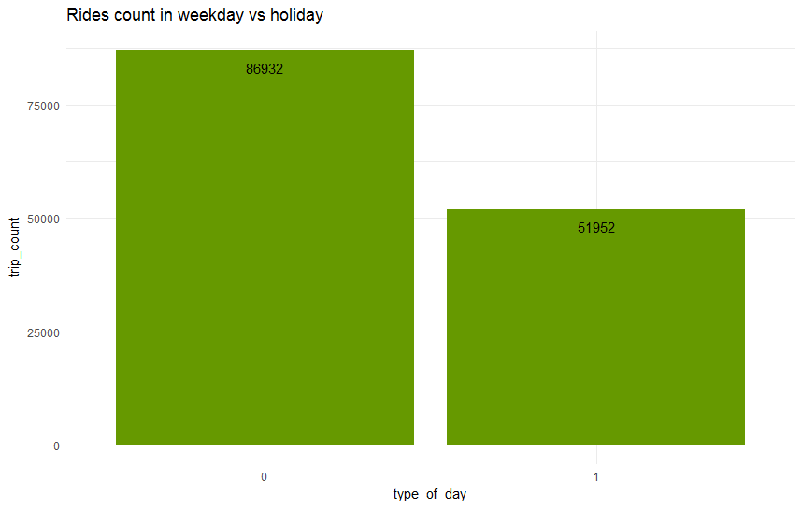
Data Exploration & Visualization
Plot of the count of trips across different hours of
working days and holidays.
Plot of the count of trips across the
week days and holidays.

Slide 9
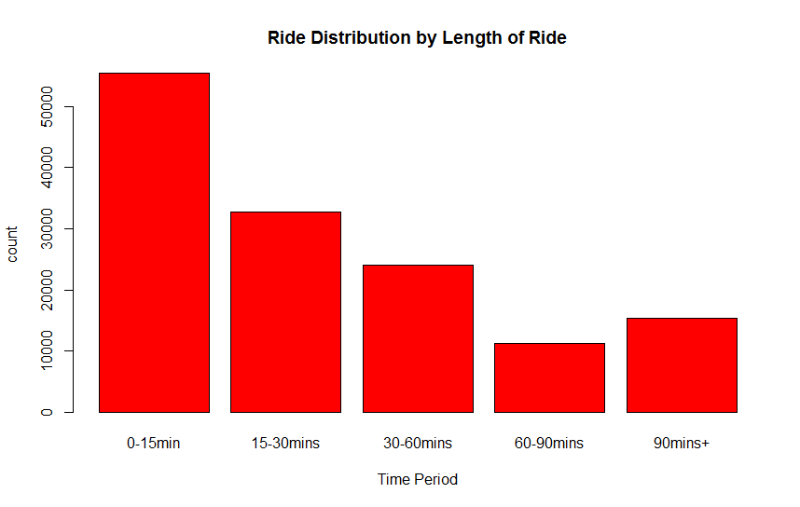
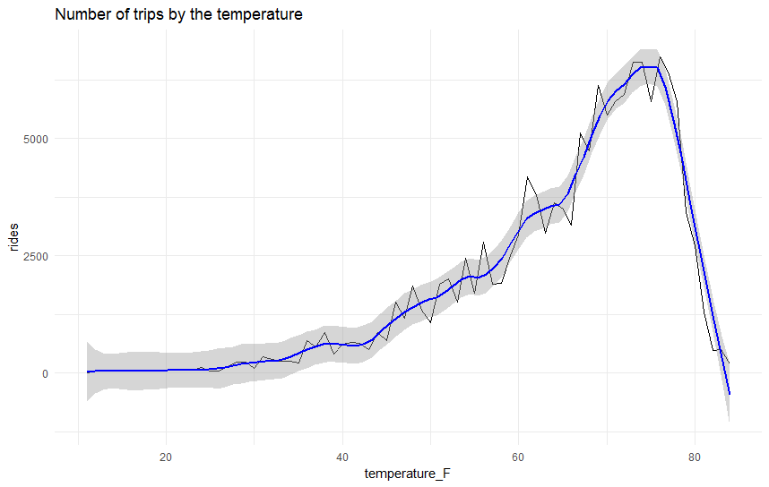
Data Exploration & Visualization
Plot of the count of bike rides in
different time periods
Plot of the count of Bikes across the
temperatures observed across each day

Slide 10
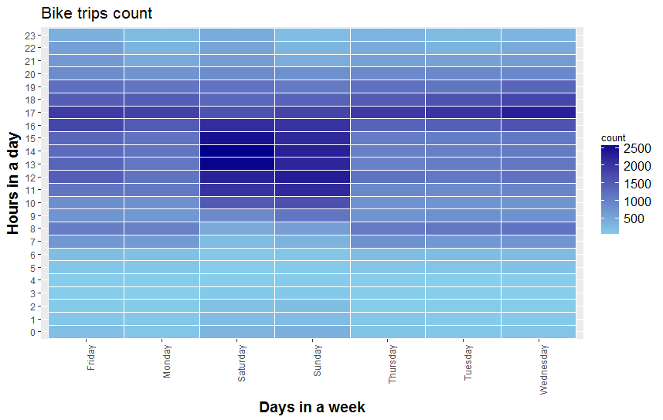
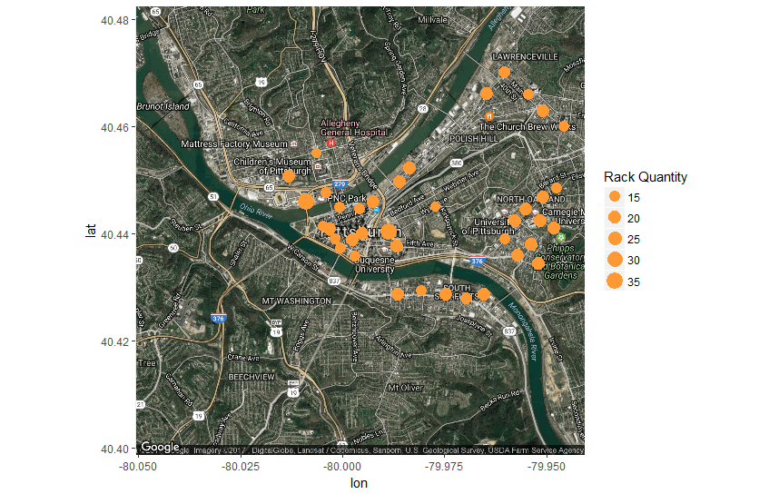
Data Exploration & Visualization
Plot of the count of bikes rented across
different hours in different days of the week
Plot of the spatial aspects of the trips

Slide 11
Data Preprocessing
Divided the dataset attributes into two subsets based on the bikes rented and returned.
Aggregated the count of bikes rented or returned at a particular hour of a day in a month at a particular station.
Difference of rent ~ return count of bikes.
If the bikes are balanced (rent=return) coded as 0 Else it is imbalanced and coded as 1 .
Training data = 19 days Testing data = remaining days of a month

Slide 12
Methods
Classification
In our case, we applied binary classification techniques to predict the rebalancing problem. (Balanced = 0, Imbalanced = 1)
We applied five different methods, including KNN, Logistic Regression, Naive Bayes, Dtree and Adaboost.

Slide 13
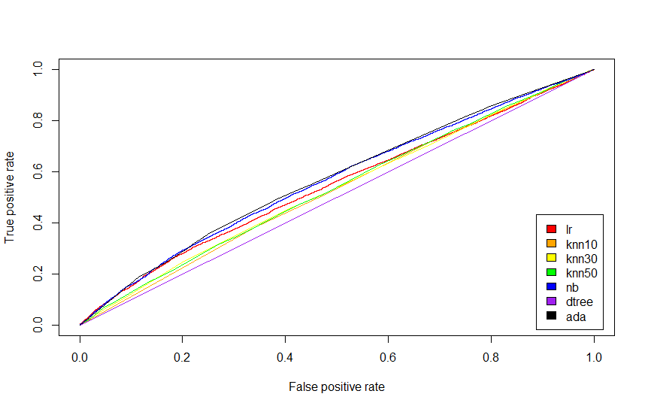
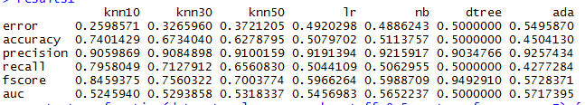
Results
ROC
Performance Measures

Slide 14
Methods
Classification
Again, we applied binary classification techniques to the imbalanced situations and built a model to predict whether the rent > return or return > rent at a particular station at a particular hour of the day.
We applied five different methods, including KNN, Logistic Regression, Naive Bayes, Dtree and Adaboost.

Slide 15
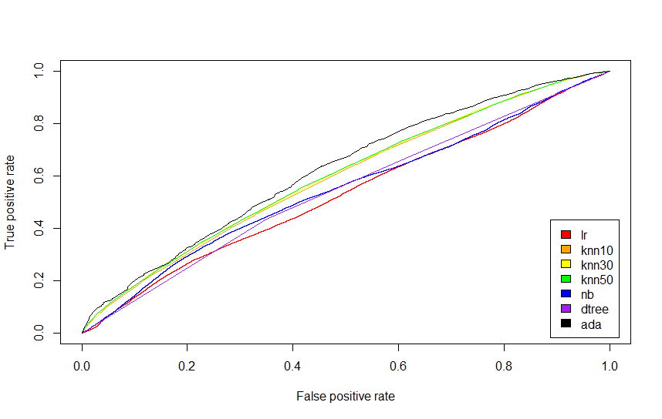
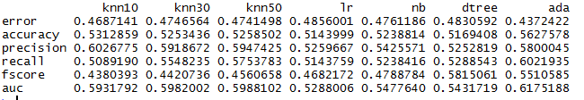
Results
ROC
Performance Measures

Slide 16
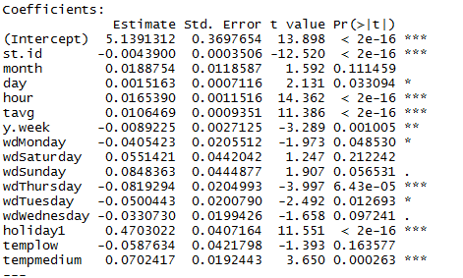
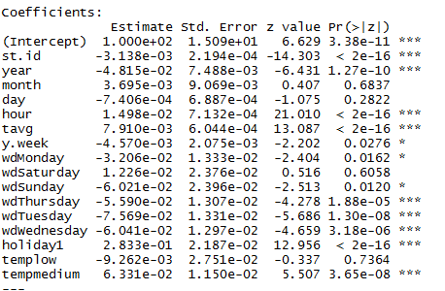
Regression
Linear regression
ME – 0.09
RMSE – 1.30
Poisson regression

Slide 17
Take Away
SVM takes considerable time on very large datasets.
Advanced Regression models need to be applied to predict the particular number of bikes at a particular station at a particular hour of a day.
More data required to train the model for better results.

Slide 18

Future Work
Classification Improvement is needed
SVM: reduce time-consumption
Parameter Tuning
Add several features like popular events in the city
E.g.: Light up night, Steelers/Pirates/Pens Games etc.

Slide 19
References
[1] Healthy ride data. https://healthyridepgh.com/data/
[2] National climatic data center. https://www.ncdc.noaa.gov/
[3] City of Pittsburgh holiday schedule. (2016) http://apps.pittsburghpa.gov/pcsc/2016 Holiday Schedule.pdf.
[4] City of Pittsburgh holiday schedule. (2015) http://apps.pittsburghpa.gov/pcsc/2015 Holiday Schedule.pdf.
[5] http://suds-cmu.org/2016/04/21/whats-happening-with-healthy-ride/
[6] http://lejnine.com/bike_analysis.html
[7] http://www.laurenrenaud.com/blog/2016/2/1/healthy-ride-pgh-bike-share-data

Slide 20
THANK YOU!!

